Slide 1

How can you support your child to stay safe online?

Slide 2
By the end of this slideshow you will know:
where to look to get advice on using technology safely,
be aware of drawbacks and common thinking traps when you use social media,
What to do if your child is a victim of cyber-bullying.

Slide 3
What do we do in school?
Online safety training for all year groups:
Keeping personal information safe
Understanding about digital footprints
Keeping passwords secure
Cyber-bullying awareness
Harmful content awareness
How to behave responsibly online
Awareness of using artificial intelligence responsibly

Slide 4
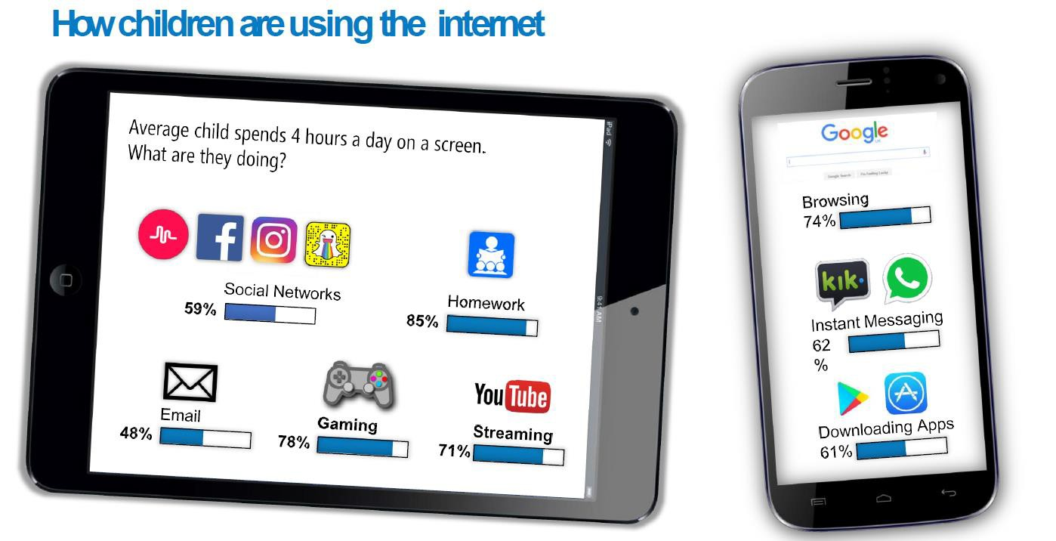

Slide 5
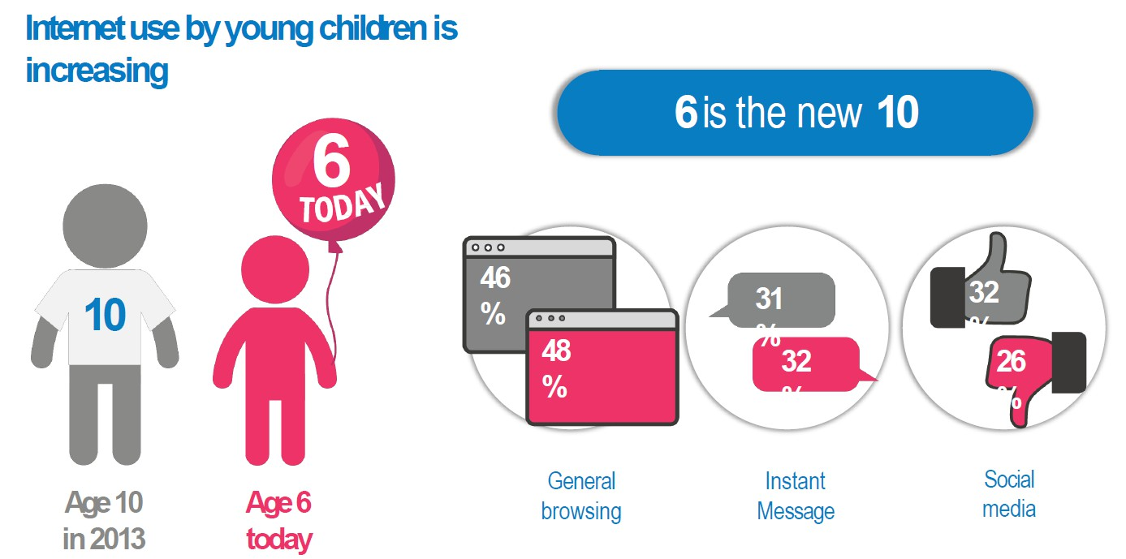

Slide 6
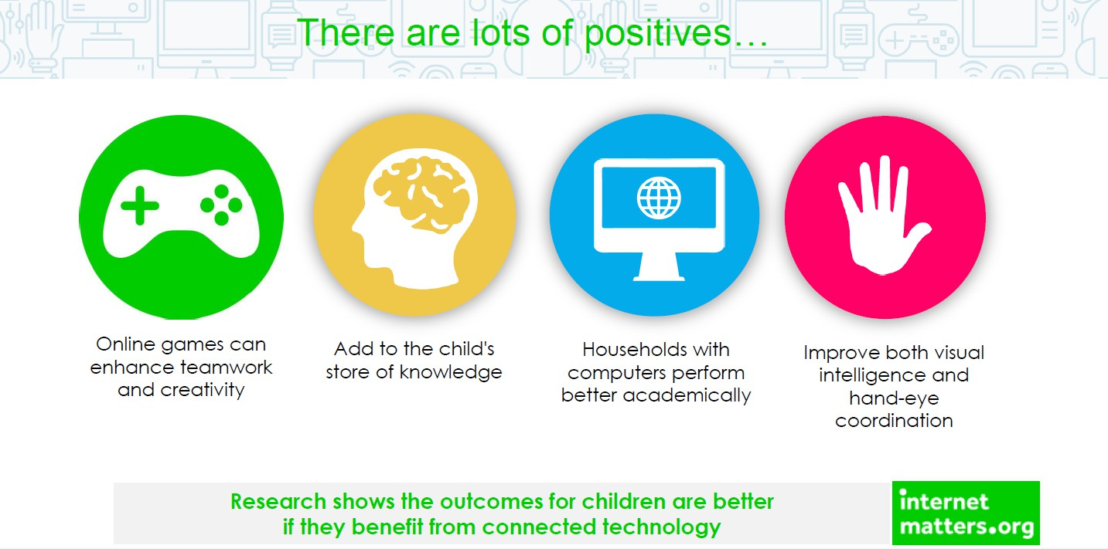

Slide 7
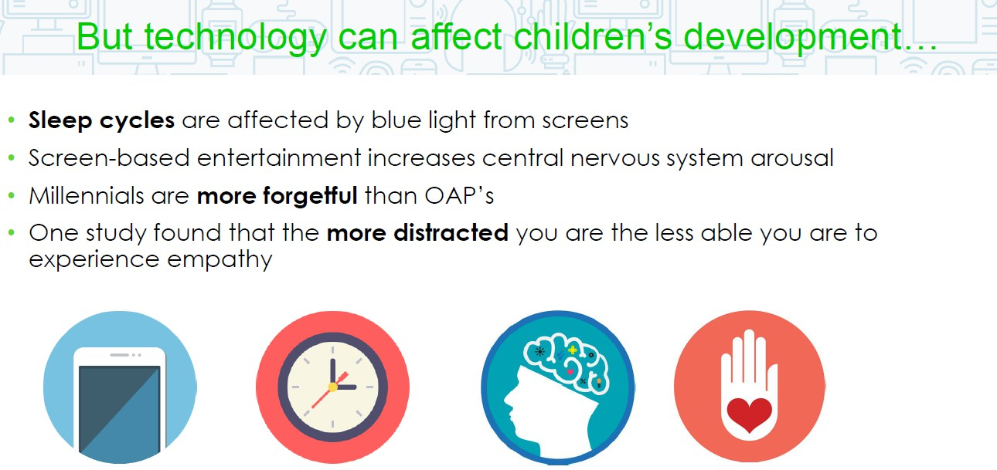

Slide 8
What are the risks of using technology?
Cyber bullying
Grooming
Inappropriate websites
Losing control over pictures and video
Giving out too much information online
Viruses, hacking and security

Slide 9

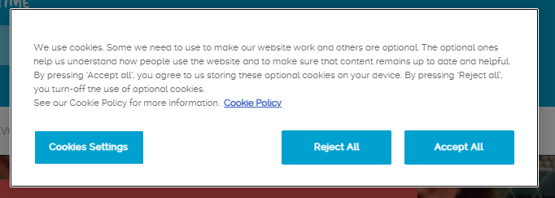
What can you do to keep your child safe?
Teach your child to reject cookie settings. If you accept cookie settings you are giving permission to be tracked across websites and for this information to be sold to third parties. Your cookie footprints across websites can then be linked on the dark web and lead to your identity being stolen.

Slide 10
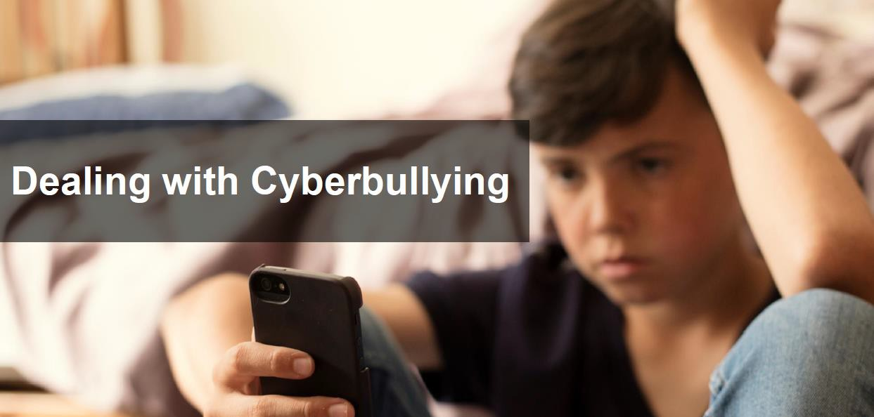


Slide 11
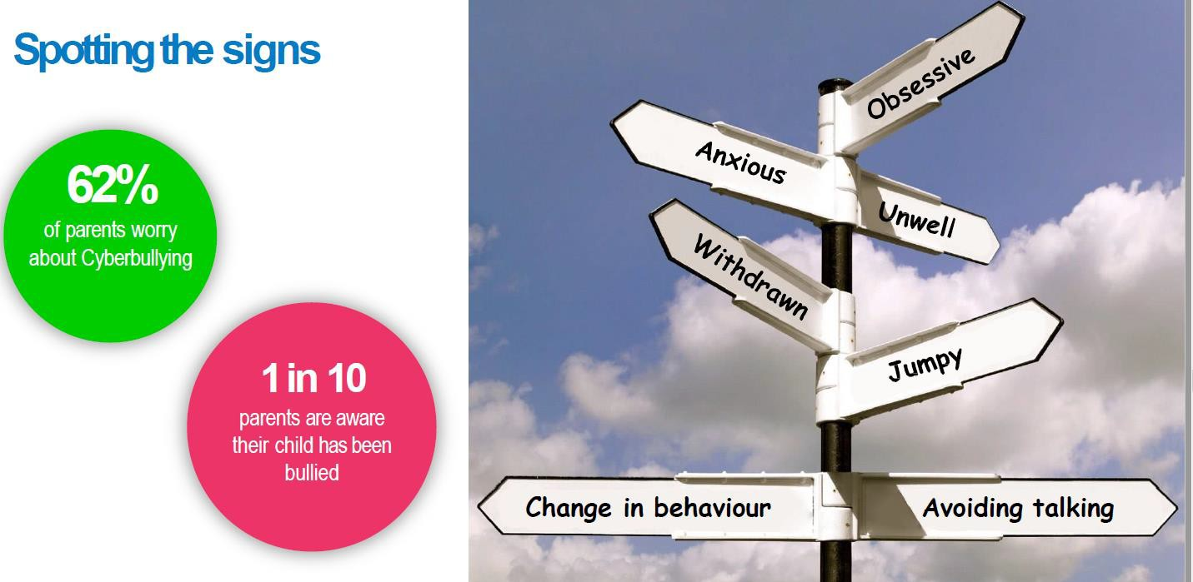

Slide 12
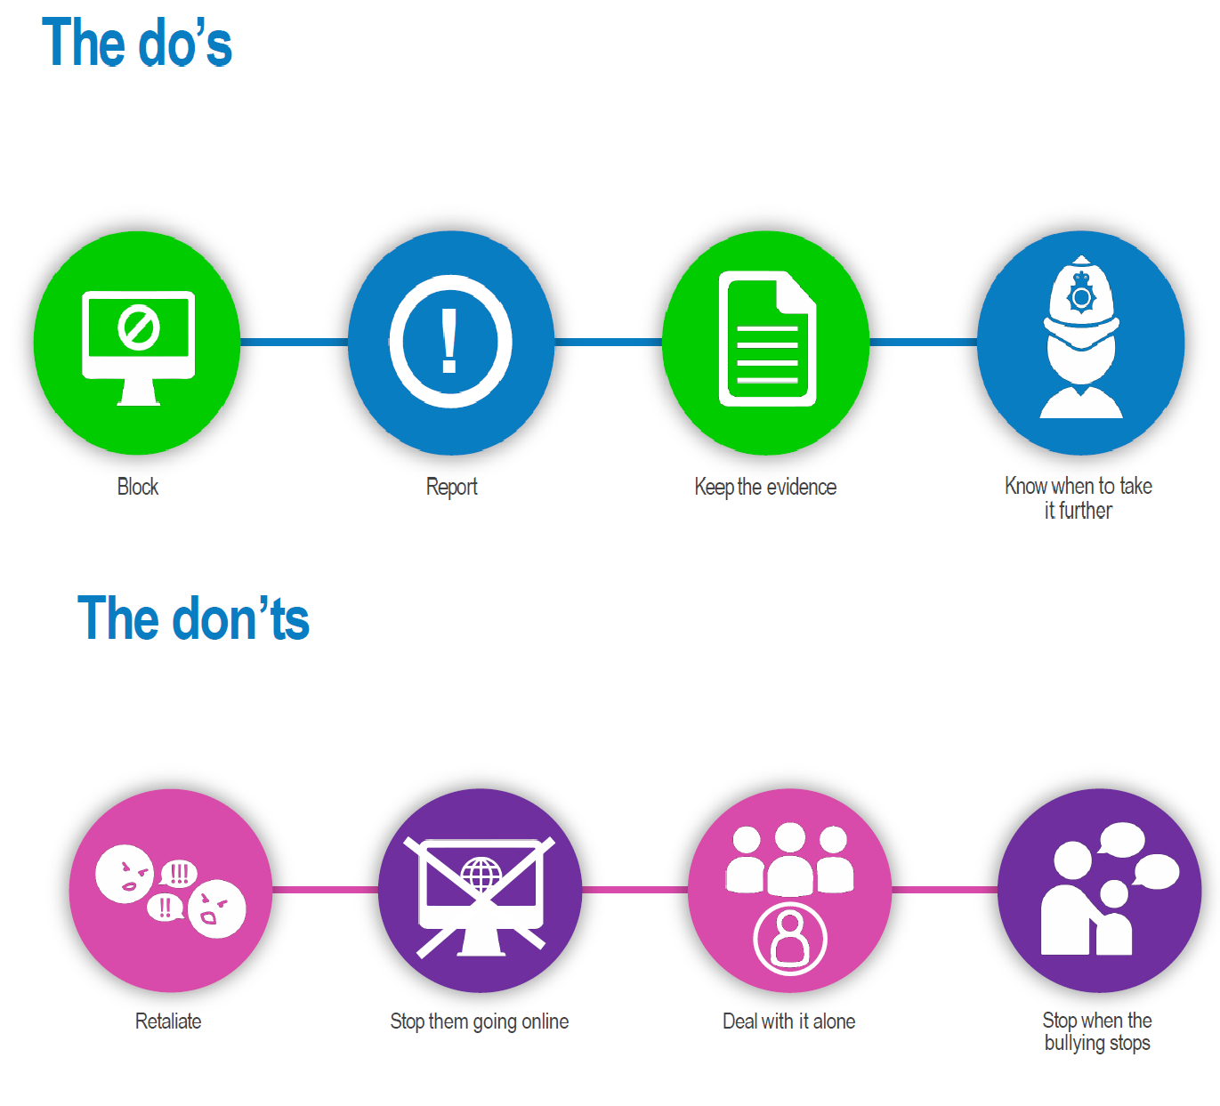

Slide 13
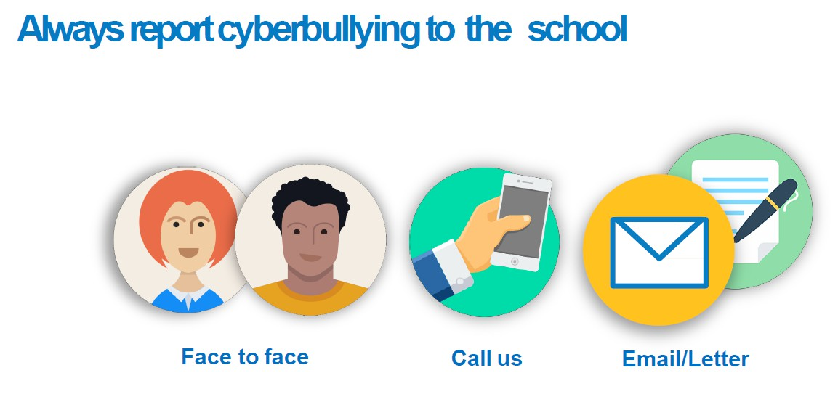

Slide 14

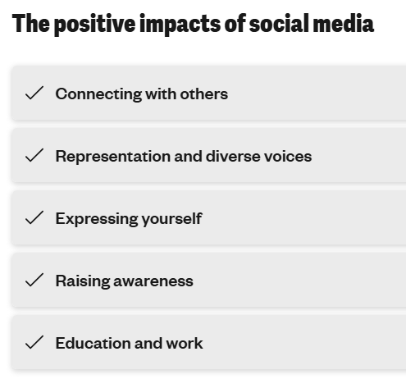
Social media has many positives…

Slide 15

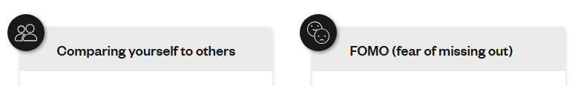
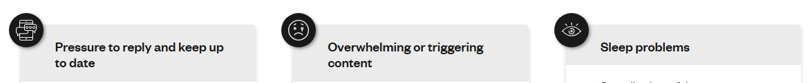
… but be aware of the dangers of social media too.

Slide 16
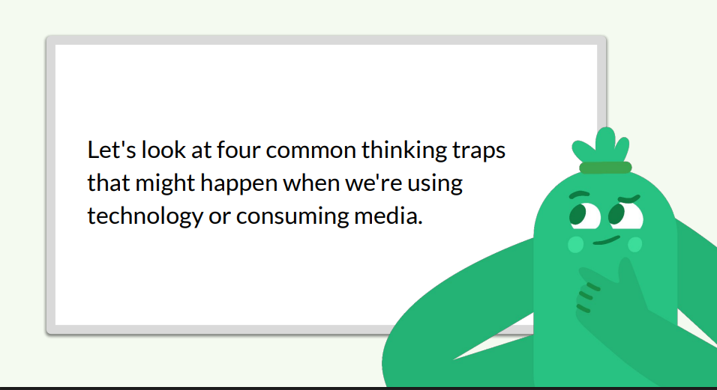

.

Slide 17
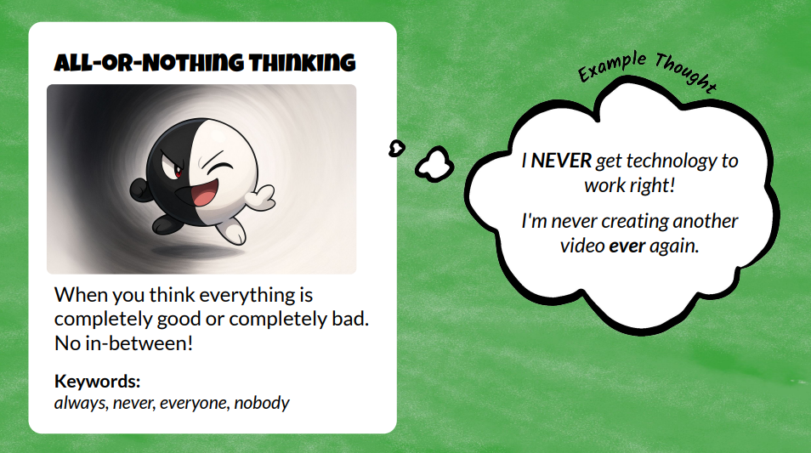
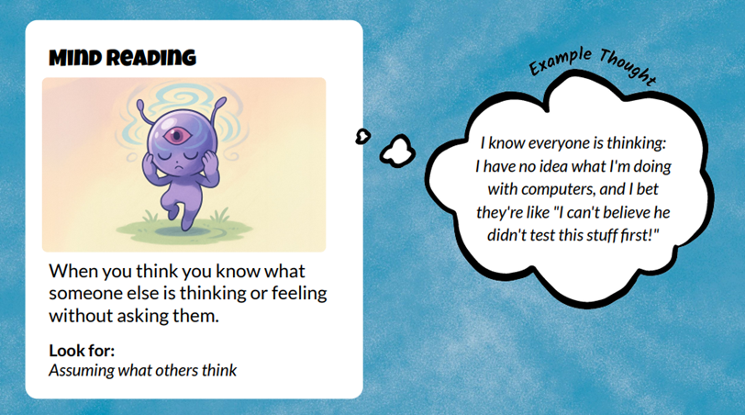
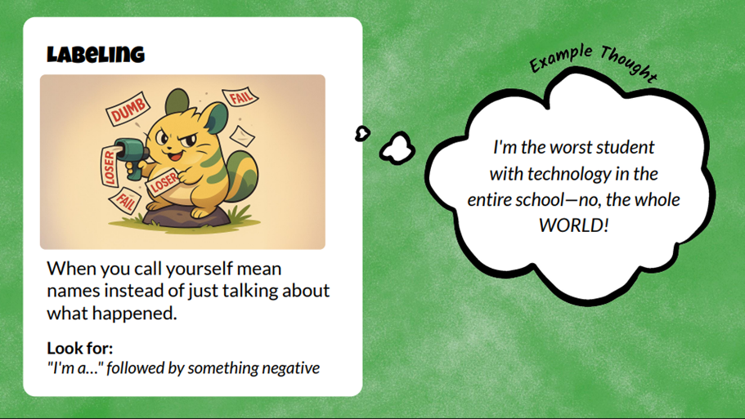
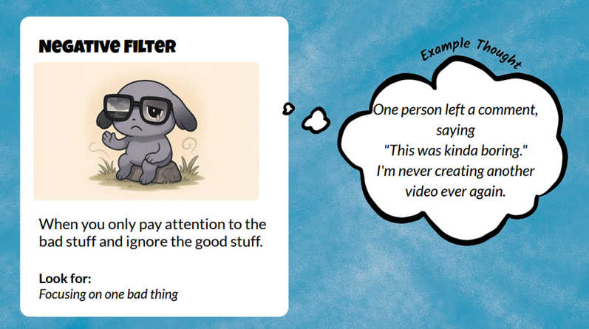
Challenge your child to find the evidence to prove their negative thoughts.

Slide 18

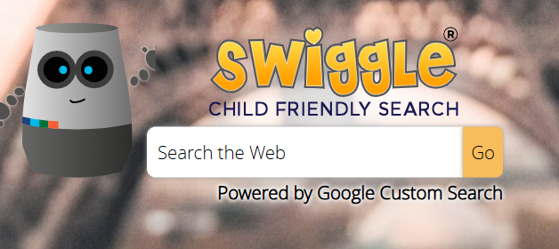
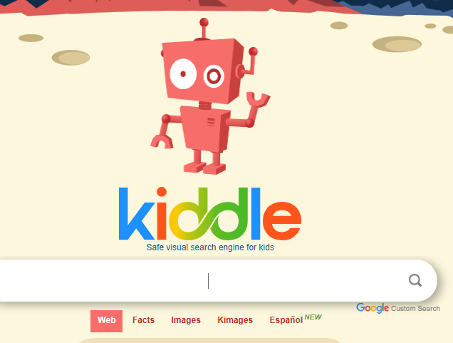
Use child friendly search engines.

Slide 19
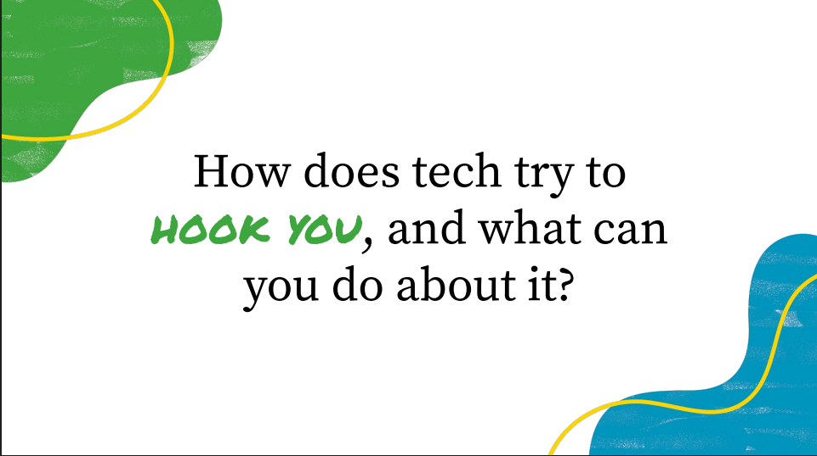


Slide 20
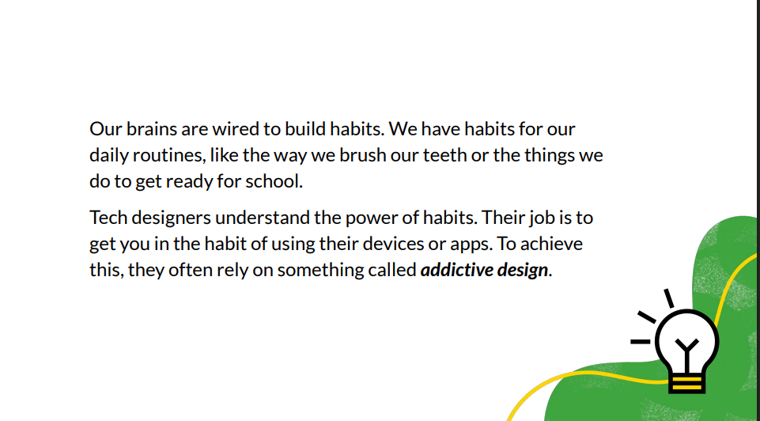

Slide 21
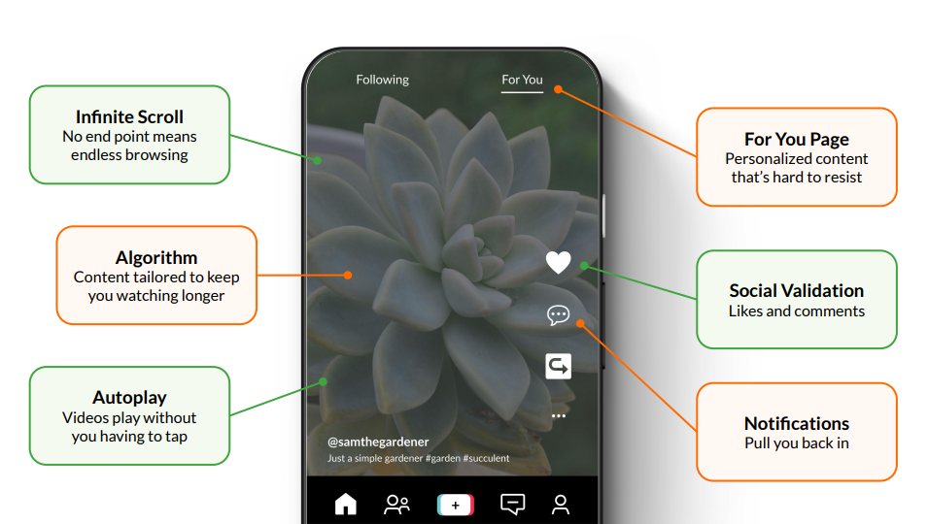
E.g. TikTok, Snapchat, Instagram, YouTube, Netflix, Facebook

Slide 22

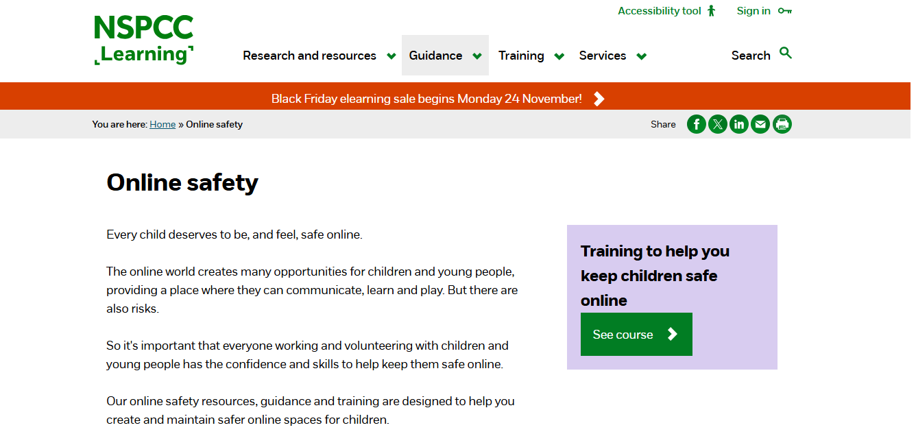
Learn about online safety on the NSPCC website.

Slide 23

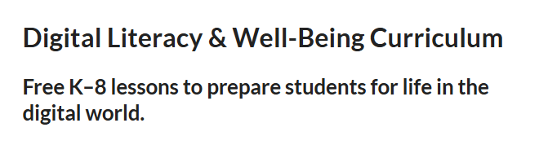
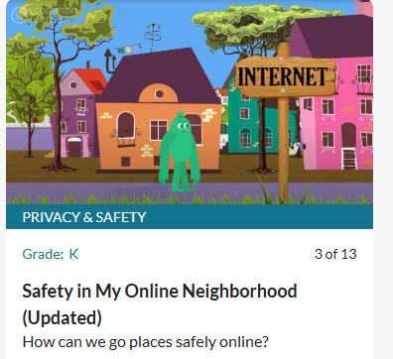
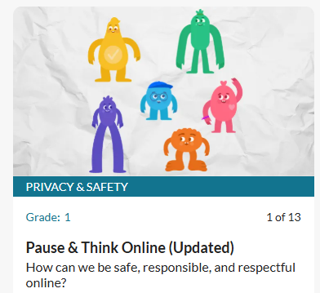
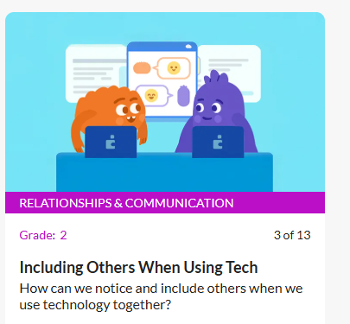
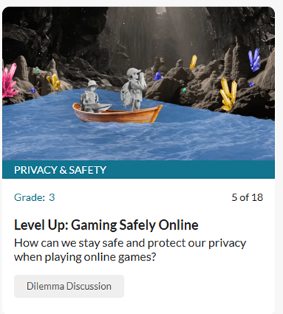
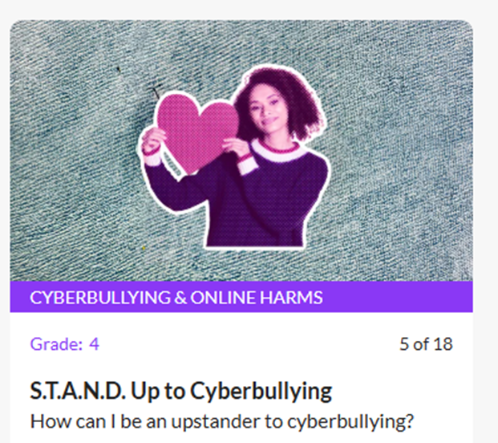
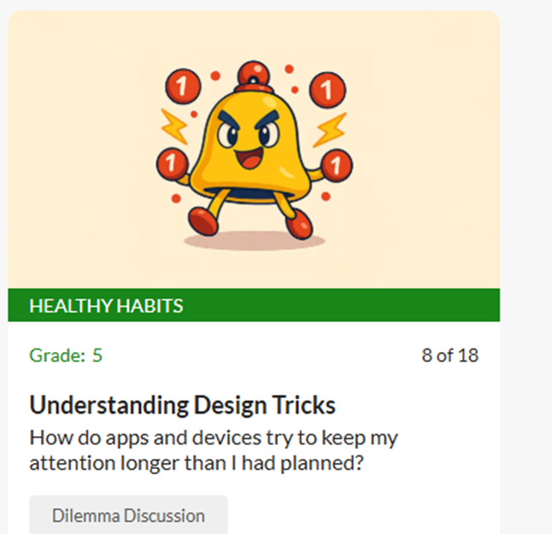
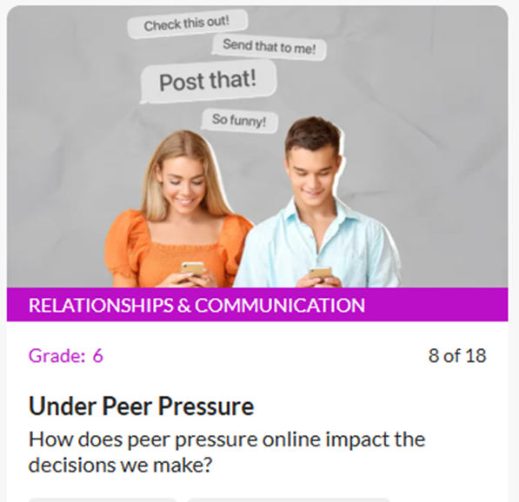
Use the digital wellbeing curriculum to teach your children about online safety.

Slide 24

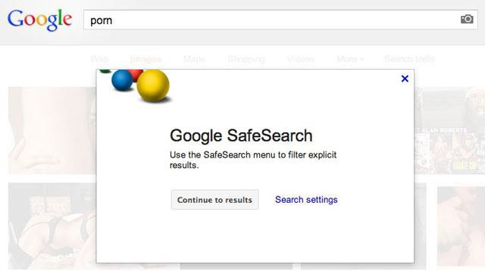


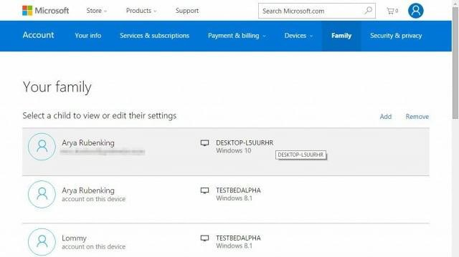
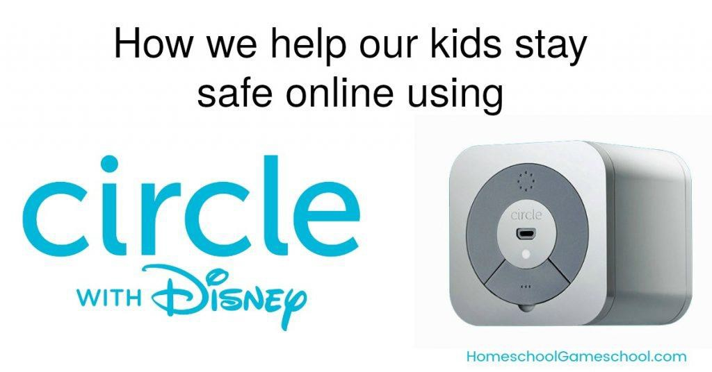
Being in control

Slide 25

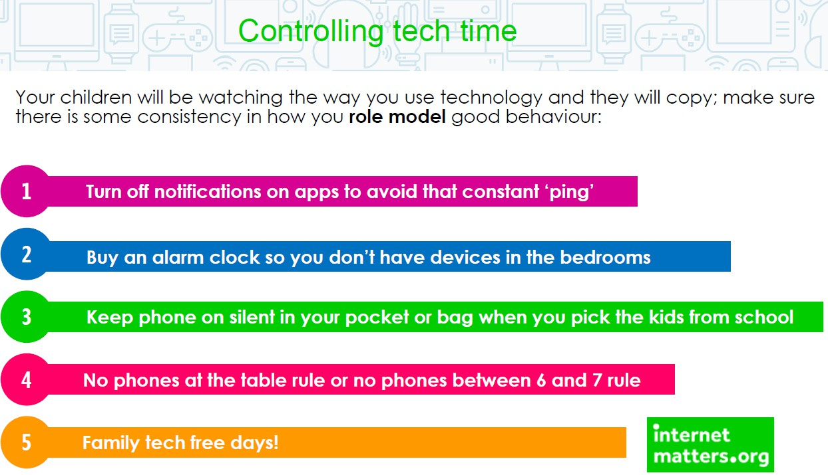

Slide 26
Tips and Advice
Be engaged! – e.g. discuss their favourite emojis or YouTuber
Be aware! – play their favourite games, visit their favourite websites and explore the online features of their devices
Be there! – if something goes wrong
Be kind! – People are bolder and rasher online because they think they are anonymous, but you are traceable by your IP address.

Slide 27
Useful websites
https://www.childnet.com
https://www.saferinternet.org.uk/safer-internet-day
https://www.Internetmatters.org
https://www.nspcc.org.uk/keeping-children-safe/online-safety/
https://www.ceop.police.uk/safety-centre/
https://www.commonsense.org/educatin/digital-literacy/
https://www.childline.org.ukhttps://learning.nspcc.org.uk/online-safety
https://www.bbc.co.uk/bitesize/parents
https://www.childline.org.uk/toolbox/coping-kit/

